Slide 1
State Challenge Process
Preview

Slide 2
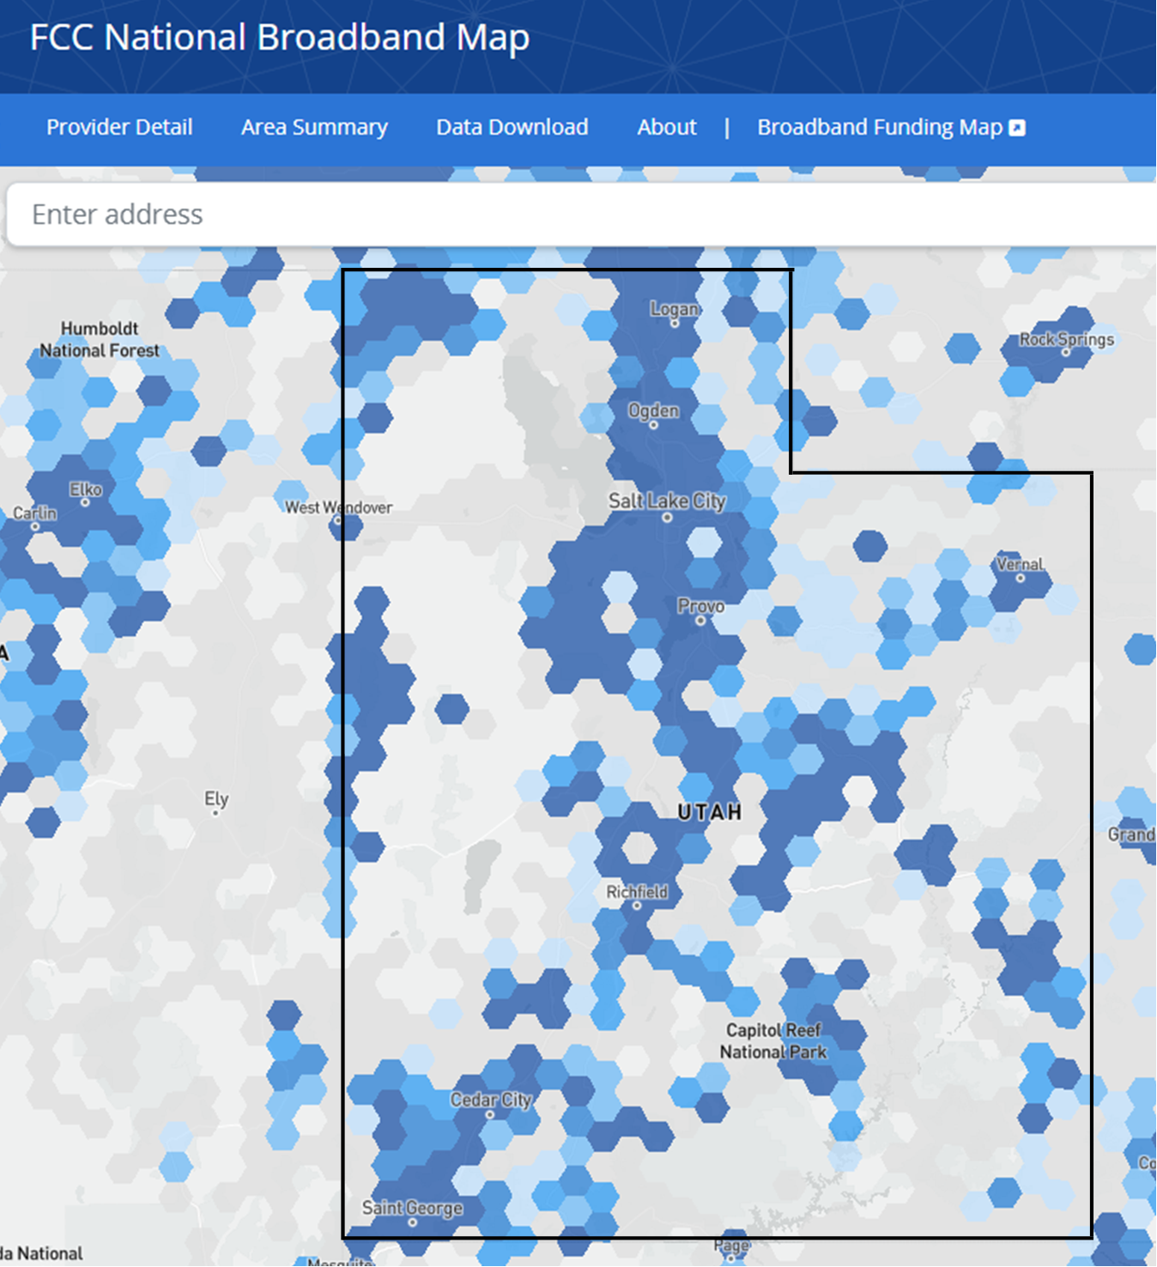
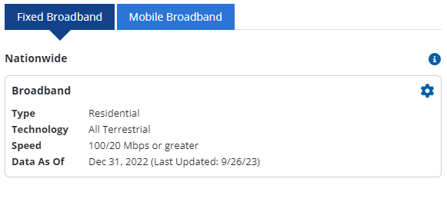
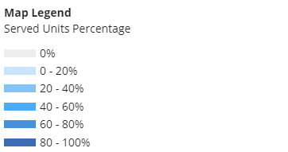
Unserved and Underserved Locations
Notes:
broadbandmap.fcc.gov
BDC
BSL

Slide 3
State Challenge Process
Purpose: Finalize the list of locations eligible for BEAD-funded projects
Eligible challengers: Internet service providers Local and Tribal governments Nonprofit organizations | Eligible challenges: Identification of eligible CAIs CAI BEAD eligibility determinations BEAD eligibility determinations for existing Broadband Serviceable Locations (BSLs) Availability Speeds Latency Data caps Technology type Service type (whether residential or business) Enforceable commitments Planned service
Notes:
Defined in Vol 1

Slide 4
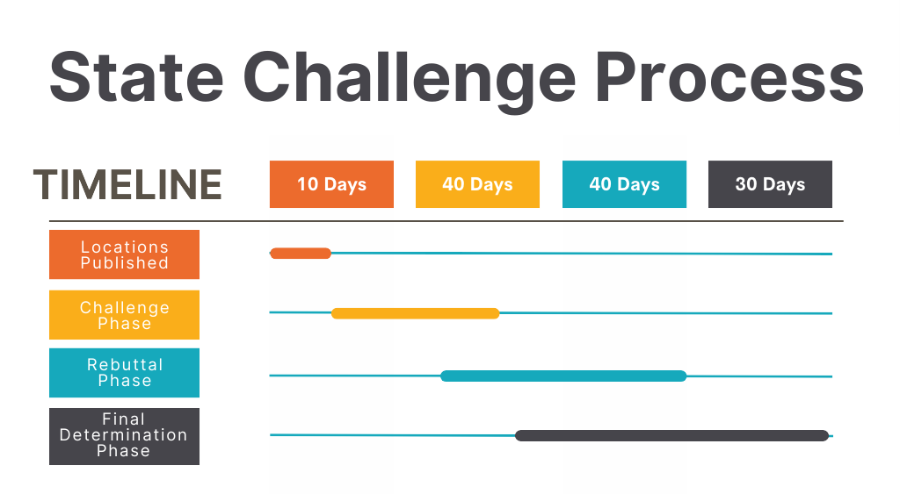
Notes:
Challenge Portal Webinars: First one, Jan 17. Grant process begins ~ June 2024
Challenge Portal Opens ~ Jan 30

Slide 5
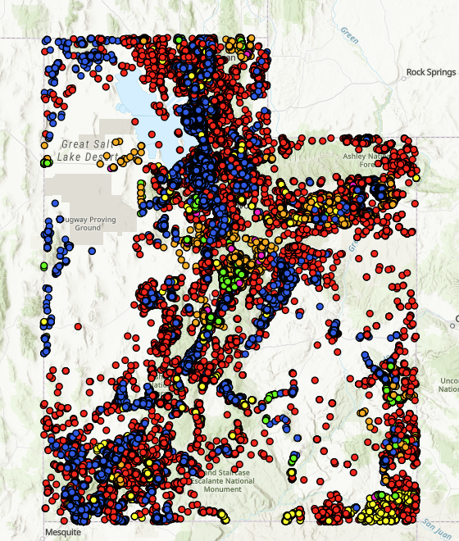
Map of Broadband Serviceable Locations (BSL)

Slide 6
Challenge Types
Code | Challenge Type | Description
A | Availability | The broadband service identified is not offered at the location, including a unit of a multiple dwelling unit (MDU).
S | Speed | The actual speed of the service tier falls below the unserved or underserved thresholds.
L | Latency | The round-trip latency of the broadband service exceeds 100 ms.
D | Data cap | The only service plans marketed to consumers impose an unreasonable capacity allowance (“data cap”) on the consumer.
T | Technology | The technology indicated for this location is incorrect.
B | Business service only | The location is residential, but the service offered is marketed or available only to businesses.
E | Enforceable Commitment | The challenger has knowledge that broadband providing at minimum 100/20 Mbps and latency of less than 100 ms to ensure it meets the qualification of served will be deployed at this location by the date established in the deployment obligation.
N | Not part of enforceable commitment. | This location is in an area that is subject to an enforceable commitment to less than 100% of locations and the location is not covered by that commitment. (See BEAD NOFO at 36, n. 52.)

Slide 7
Challenge Types (Continued)
Code | Challenge Type | Description
P | Planned service | The challenger has knowledge that broadband providing at minimum 100/20 Mbps and latency of less than 100 ms will be deployed at this location by June 30, 2024 without an enforceable commitment or a provider is building out broadband offering performance beyond the requirements of an enforceable commitment.
C | Location is a CAI | The location should be classified as a CAI.
R | Location is not a CAI | The location is currently labeled as a CAI but is a residence, a non-CAI business, or is no longer in operation.

Slide 8
Existing Broadband Funding
Rural Digital Opportunity Fund (RDOF)
Rural E-connectivity Program (REP)
Tribal Broadband Connectivity Program (TCBP)
Telephone Loan Program (TLP)
Connect America Fund Phase II (CAF II)
Community Connect Grant Program (CCGP)
Broadband Infrastructure Program (BIP)
Utah Broadband Access Grant (BAG)
Notes:
https://docs.google.com/spreadsheets/u/1/d/e/2PACX-1vTYRi3eiLoqixHsalB5dBfPrlLd5EihmhoFpeLflqp3f-4FIwr7v5ip7zt3E9_ojg/pubhtml#

Slide 9
Community Anchor Institutions (CAIs)
Definition: An entity such as a school, library, health clinic, health center, hospital or other medical provider, public safety entity, institution of higher education, public housing organization, or community support organization that facilitates greater use of broadband service by vulnerable populations, including low-income individuals, unemployed individuals, and aged individuals.

Slide 10
What is an FCC Fabric (Broadband Map) License?
And why does my organization need one?
Ensure the broadband office can share the FCC’s Fabric Locations data with the challenger.
Access FCC Fabric data identifiers: broadband-serviceable locations (BSLs)
Download the list of unserved and underserved locations (BSL id numbers vs addresses).
Ease participation in state Broadband Challenge Process; ensure internet speed availability
Ensure needed BEAD funds are going to your community
Notes:
Having an FCC Fabric License will permit your organization to look at certain data that makes up the FCC Fabric. Specifically, it will allow you to look at broadband-serviceable locations (BSLs) in Utah.
Having access to the BSLs will help you interpret the list of unserved and underserved locations (which are provided using Fabric BSL id numbers rather than street addresses).
This will help you prepare to participate in the state challenge process and make sure that all locations are correctly designated as either served, underserved, or unserved.
By requesting a Fabric license and using it to verify the BSLs in your community, you can help the State make sure that BEAD funds are going where they are most needed, and that all Utah communities have access to high-speed internet!

Slide 11
What type of license do I need?
I’m a unit of local government or a non-profit
I’m an internet service provider
Tier E License
The application request form is found at https://apps.costquest.com/ ntiatiererequest/
Tier D License
The application request form is found at https://apps.costquest.com/ NTIArequest/

Slide 12
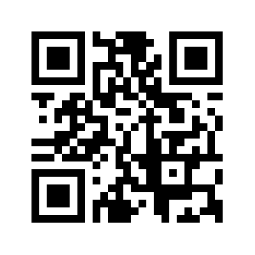
Resources
Utah Five-Year Digital Connectivity Plan at ConnectingUtah.com
Utah’s Initial Proposal at ConnectingUtah.com
Getting an FCC map fabric license slides *
Summary of Challenge *
Connectingutah.com/state-challenge-process *
Webinars for Challenge Portal and Submission Process:
Jan 17 - General Overview
Jan 23 - Local & Tribal Governments and Nonprofits
Jan 25 - Internet Service Providers

Slide 13
broadbandcenter@utah.gov 385-443-3174

